Slide 1
CHRISTMAS TREE WATERING PROJECT
JAAKKO MANSIKKA
JAMES MURIITHI

Slide 2
COMPONENTS
Arduino Yun
9V power supply
5V DC water pump
5V relay
LM2596 step down power module
Soil moisture sensor
Connecting wires
Breadboard

Slide 3


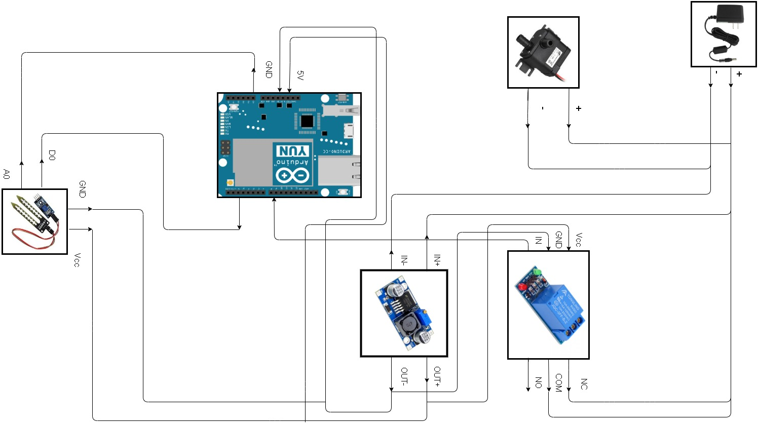

Slide 4
HOW IT WORKS
Based on the readings from the soil sensor, the Yun board will send comands to the relay to either turn on the pump allowing for water to flow out.
The LM2596 module is used to step down the 9V from the power supply to the 5V necessary to power the Yun board.
ADD+

Slide 5

THANK YOU FOR LISTENING

